Slide 1
AWS+HealthEdge
Compliance Summary
Lead: Alexandria Burke, M.S., CISSP, Lead-CCA, Certified CSF Practitioner
Senior Privacy and Security Consultant
Shreya Singh, CISA
Assurance Security Consultant

Slide 2
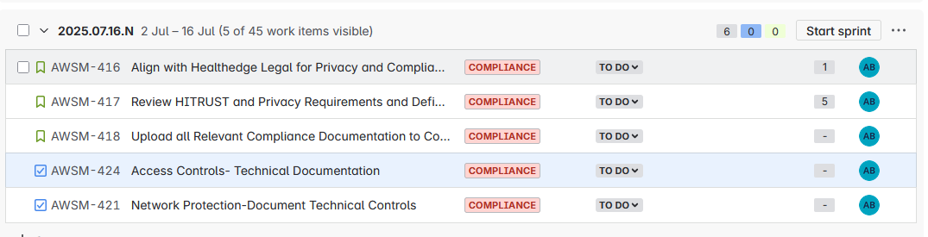
Sprint 1
Notes:
Throughout the session if you identify RAIDD items, actions, or off-topic items, please write a sticky and put them on the wall in the appropriate page and we’ll review them when we get to that point

Slide 3
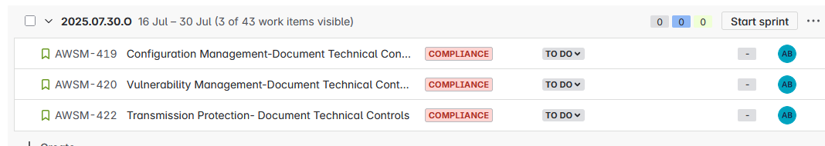
Sprint 2
Notes:
Throughout the session if you identify RAIDD items, actions, or off-topic items, please write a sticky and put them on the wall in the appropriate page and we’ll review them when we get to that point

Slide 4
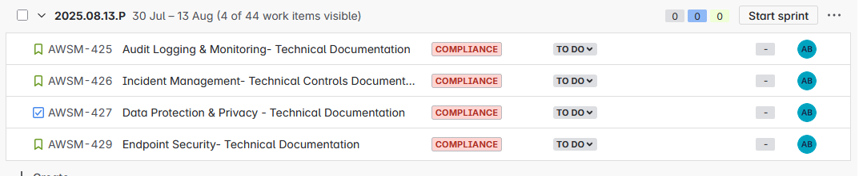
Sprint 3
Notes:
Throughout the session if you identify RAIDD items, actions, or off-topic items, please write a sticky and put them on the wall in the appropriate page and we’ll review them when we get to that point

Slide 5
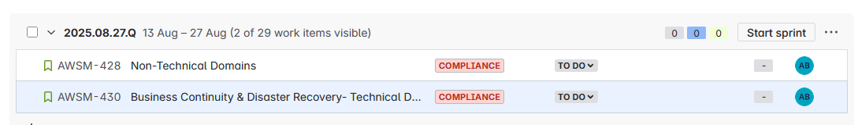
Sprint 4

Slide 6
Risks
8 | SAS/Compliance | Assurance Consultant Exposure to PHI | 3 | 5 | Critical | Alexandria Burke |  | 6/26/2025 |  |  | 2. Open | Ensuring the Assurance Consultant is not exposed to PHI, to date SAS employees are not covered by the ProServe BAA. Its not a problem for the Sr in Compliance since they still work for AWS and not on SAS paper. The Senior will ensure that if any screen sharing occues no PHI will be present. The Compliance documents will be screened by the Senior to ensure no PHI is present.
9 | SAS/Compliance | Dependcies with other Workstreams | 3 | 5 | Critical | Alexandria Burke |  | 7/1/2025 |  |  | 2. Open | Ensure Confluence is properly documented with configuration requirements based on control guidelines and establish checkpoint meetings with workstream leads for updates and ensure we anticipate or are able to address any unforeseen security/compliance risks
Notes:
Throughout the session if you identify RAIDD items, actions, or off-topic items, please write a sticky and put them on the wall in the appropriate page and we’ll review them when we get to that point

